Slide 1

PhD Image Holder
Trying to consolidate and structure everything under one location

Slide 2
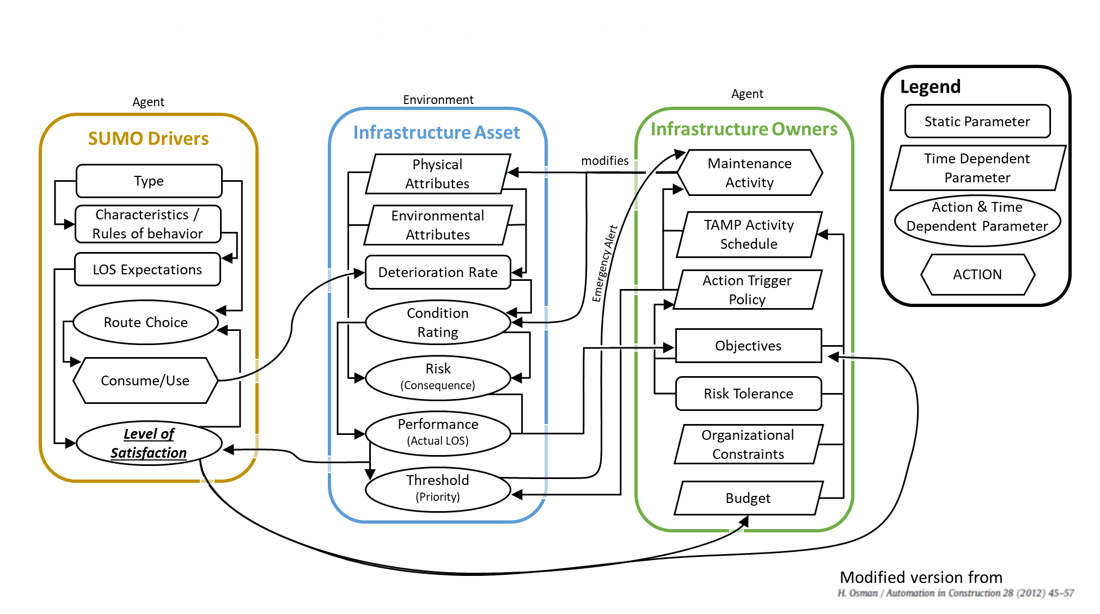
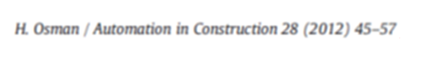
PhD Research - Agents and Roadway (environment) Dynamics
Agent
Legend
Agent
Environment
Infrastructure Asset
Infrastructure Owners
Static Parameter
SUMO Drivers
Physical Attributes
modifies
Maintenance Activity
Time Dependent Parameter
Type
Action & Time Dependent Parameter
Characteristics / Rules of behavior
Environmental Attributes
TAMP Activity Schedule
LOS Expectations
Deterioration Rate
Emergency Alert
ACTION
Action Trigger Policy
Route Choice
Condition Rating
Objectives
Consume/Use
Risk (Consequence)
Risk Tolerance
Level of Satisfaction
Performance
(Actual LOS)
Organizational Constraints
Threshold
(Priority)
Budget
Modified version from

Slide 3
PhD Research - Agents and Roadway (environment) Dynamics
Agent
Legend
Agent
Environment
Infrastructure Asset
Infrastructure Owners
Static Parameter
SUMO Drivers
Physical Attributes
modifies
Maintenance Activity
Time Dependent Parameter
Type
Action & Time Dependent Parameter
Characteristics / Rules of behavior
Environmental Attributes
TAMP Activity Schedule
LOS Expectations
Deterioration Rate
Emergency Alert
ACTION
Action Trigger Policy
Route Choice
Condition Rating
Objectives
Consume/Use
Risk (Consequence)
Risk Tolerance
Level of Satisfaction
Performance
(Actual LOS)
Organizational Constraints
Threshold
(Priority)
Budget
Modified version from

Slide 4
Agent
Legend
Network Demand
Virtual Network
Infrastructure Asset
Infrastructure Owners
Static Parameter
SUMO Drivers
Physical Attributes
modifies
Maintenance Activity
Time Dependent Parameter
Type
Action & Time Dependent Parameter
Characteristics / Rules of behavior
Environmental Attributes
TAMP Activity Schedule
LOS Expectations
Deterioration Rate
Emergency Alert
ACTION
Action Trigger Policy
Route Choice
Condition Rating
Objectives
Consume/Use
Risk (Consequence)
Risk Tolerance
Level of Satisfaction
Performance
(Actual LOS)
Organizational Constraints
Threshold
(Priority)
Budget
Relationship Visualization concept from:
H. Osman / Automation in Construction 28 (2012) 45-57

Slide 5
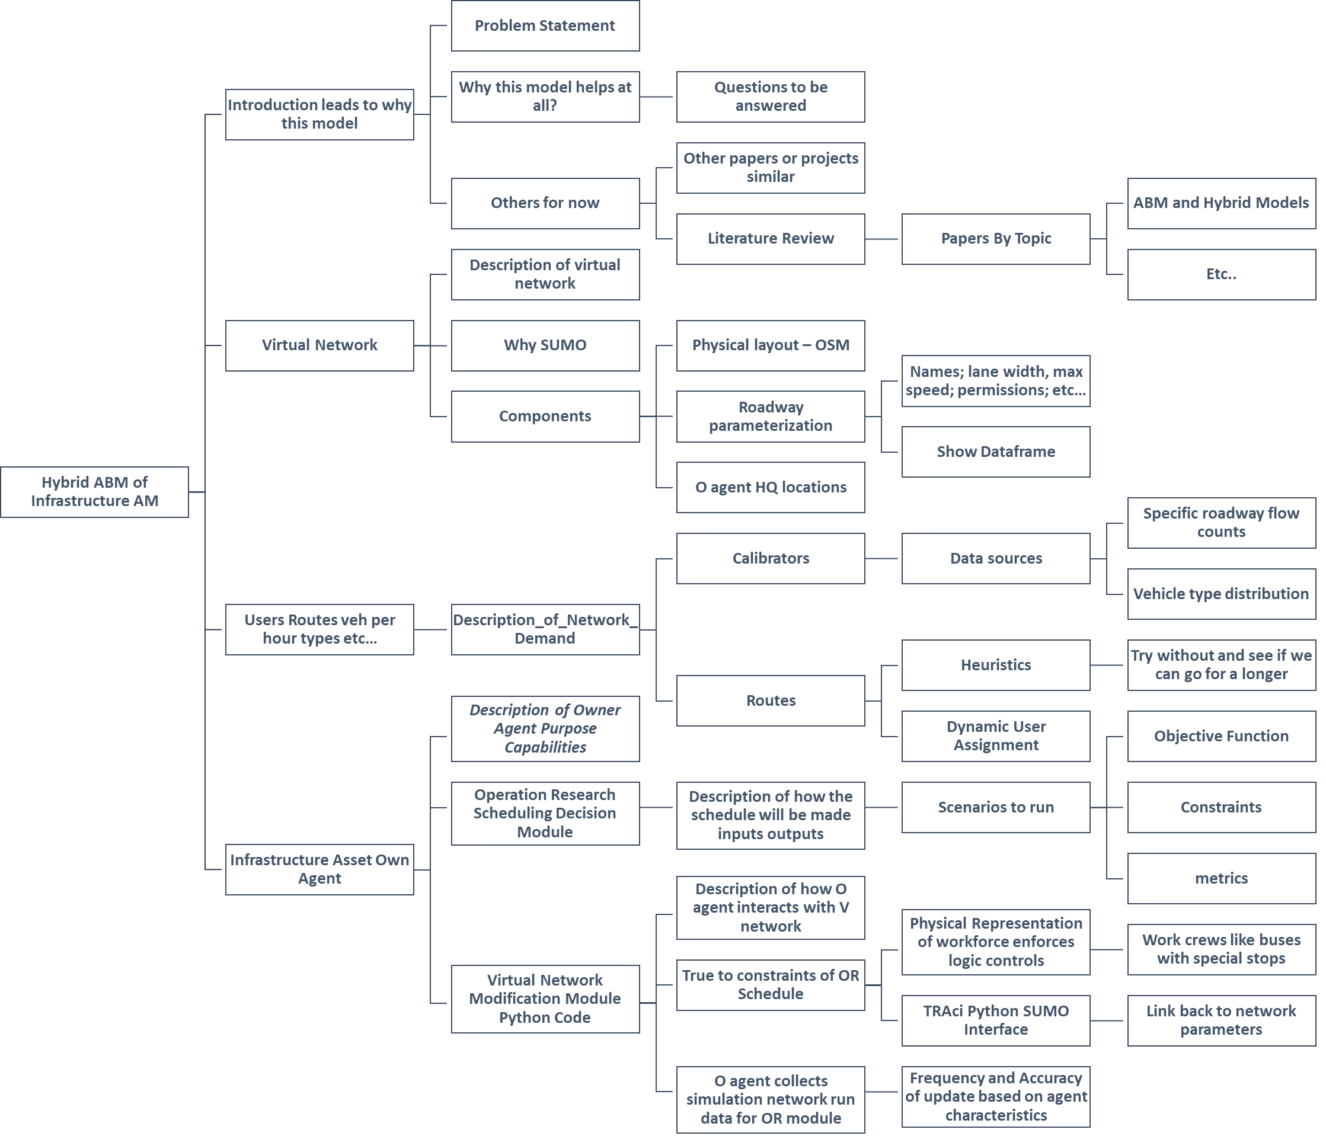

Slide 6
Introduction and Background Info
Problem Statement
Why this model helps at all?
Questions to be answered
Introduction leads to Why this Model is Relevant?
Transportation Asset Management
Very relevant papers or projects
Background and Literature Review
ABM and Hybrid Models
Literature Review
Papers By Topic
Etc..
Hybrid ABM of Infrastructure AM
Description of virtual network
Virtual Network
Why SUMO
Physical layout – OSM
Names; lane width, max speed; permissions; etc…
Components
Roadway parameterization
Show Dataframe
O agent HQ locations
Specific roadway flow counts
Description_of_Network_Demand
Users
Routes
veh per hour
types
etc…
Calibrators
Data sources
Vehicle type distribution
Network Demand
Users Behavior
Heuristics
Try without and see if we can go for a longer
Routes
Dynamic User Assignment
Description of Owner Agent Purpose Capabilities
Objective Function
Operation Research Scheduling Decision Module
Description of how the schedule will be made inputs outputs
Scenarios to run
Constraints
Infrastructure Asset Own Agent
Description of how O agent interacts with V network
metrics
Physical Representation of workforce enforces logic controls
Work crews like buses with special stops
Virtual Network Modification Module Python Code
True to constraints of OR Schedule
TRAci Python SUMO Interface
Link back to network parameters
O agent collects simulation network run data for OR module
Frequency and Accuracy of update based on agent characteristics

